Slide 1
Pest or Disease Risk Prediction System
Name: Mayavathi S
S Meghana
College: Alliance University

Slide 2
SDG Alignment
SDG 2 – Zero Hunger
SDG 15 – Life on Land

Slide 3
Problem Statement
Farmers often suffer crop losses due to pests and plant diseases because early warning information is limited or unavailable. Traditional methods rely on manual observation, which is time-consuming and often detects problems only after significant damage has occurred. This leads to reduced crop yield, economic loss, and excessive pesticide use.

Slide 4
AI Solution Overview
The Pest or Disease Risk Prediction System is an AI-based decision-support tool that:
Analyzes historical crop, weather, and environmental data
Identifies patterns linked to pest or disease outbreaks
Predicts risk levels (Low / Medium / High)
Provides preventive and eco-friendly advisory suggestions
Helps farmers take timely action to protect crops
The system focuses on early warning and prevention, not diagnosis.

Slide 5
Target Users
Farmers
Agricultural extension officers
Farming communities
Agriculture students and researchers

Slide 6
Role of AI
Pattern detection in weather and crop data
Risk classification (Low / Medium / High)
Predictive analysis for potential outbreaks
Recommendation generation for preventive measures

Slide 7
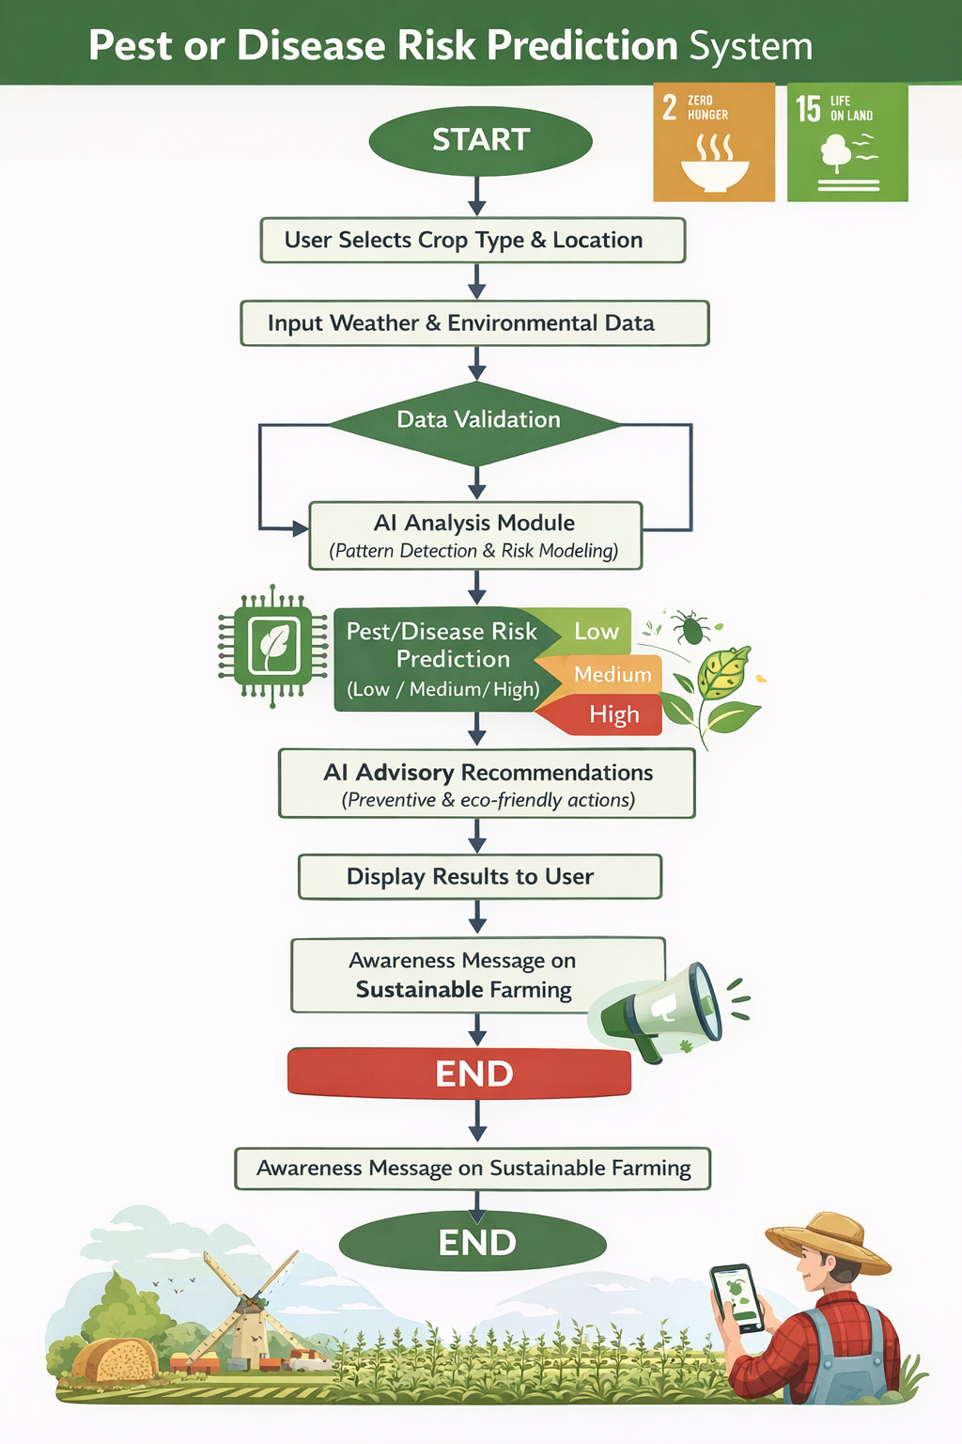
Flow Chart

Slide 8
Responsible AI Considerations
Fairness: General agricultural data used, not biased toward specific regions or farmers
Transparency: Risk prediction logic is explained in simple terms
Ethics: No chemical overuse promotion or harmful advice
Privacy: No personal or sensitive farmer data collected

Slide 9
Expected Impact
Reduced crop losses
Early pest and disease awareness
Lower pesticide usage
Improved crop yield and farmer income
Promotion of sustainable agriculture

Slide 10
What changes if this solution is implemented?
What changes if this solution is implemented?
Farmers receive early warnings about potential pest or disease risks, allowing them to take preventive action before major damage occurs.
Who benefits and how?
Farmers: Reduced losses and better yields
Communities: Improved food security
Environment: Reduced chemical usage and healthier ecosystems

